Slide 1
Java Programming
6

Slide 2
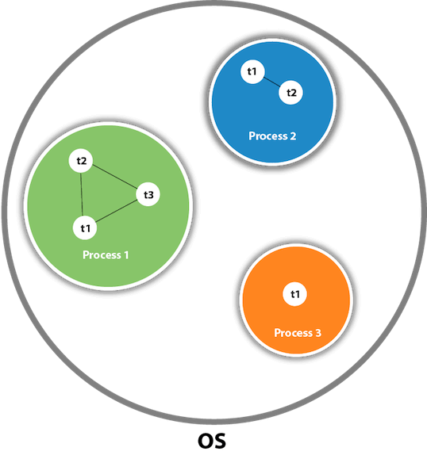
MULTITHREADING
Multithreading in Java is a process of executing multiple threads simultaneously.
A thread is a lightweight sub-process, the smallest unit of processing. Multiprocessing and multithreading, both are used to achieve multitasking.
However, we use multithreading than multiprocessing because threads use a shared memory area. They don't allocate separate memory area so saves memory, and context-switching between the threads takes less time than process.

Slide 3
Advantages of Java Multithreading
1) It doesn't block the user because threads are independent and you can perform multiple operations at the same time.
2) You can perform many operations together, so it saves time.
3) Threads are independent, so it doesn't affect other threads if an exception occurs in a single thread.
Multitasking:
Multitasking is a process of executing multiple tasks simultaneously. We use multitasking to utilize the CPU. Multitasking can be achieved in two ways:
Process-based Multitasking (Multiprocessing)
Thread-based Multitasking (Multithreading)

Slide 4
1)Process-based Multitasking (Multiprocessing)
Each process has an address in memory. In other words, each process allocates a separate memory area.
A process is heavyweight.
Cost of communication between the process is high.
Switching from one process to another requires some time for saving and loading registers, memory maps, updating lists, etc.
2) Thread-based Multitasking (Multithreading)
Threads share the same address space.
A thread is lightweight.

Slide 5
JAVA THREAD CLASS
Java provides Thread class to achieve thread programming. Thread class provides constructors and methods to create and perform operations on a thread. Thread class extends Object class and implements Runnable interface.
Life cycle of a Thread (Thread States)
In Java, a thread always exists in any one of the following states. These states are:
New
Active
Blocked / Waiting
Timed Waiting
Terminated

Slide 6
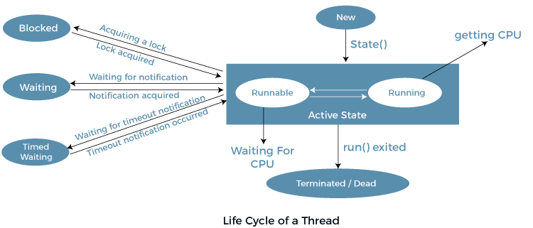

Slide 7
SYNCHRONIZATION IN JAVA
Synchronization in Java is the capability to control the access of multiple threads to any shared resource.
Java Synchronization is better option where we want to allow only one thread to access the shared resource.
Why use Synchronization?
The synchronization is mainly used to
To prevent thread interference.
To prevent consistency problem.
Concept of Lock in Java:
Synchronization is built around an internal entity known as the lock or monitor. Every object has a lock associated with it. By convention, a thread that needs consistent access to an object's fields has to acquire the object's lock before accessing them, and then release the lock when it's done with them.

Slide 8
JAVA SYNCHRONIZED METHOD
Java Synchronized Method
If you declare any method as synchronized, it is known as synchronized method.
Synchronized method is used to lock an object for any shared resource.
When a thread invokes a synchronized method, it automatically acquires the lock for that object and releases it when the thread completes its task.
Priority of a Thread (Thread Priority)
Each thread has a priority. Priorities are represented by a number between 1 and 10. In most cases, the thread scheduler schedules the threads according to their priority (known as preemptive scheduling). But it is not guaranteed because it depends on JVM specification that which scheduling it chooses. Note that not only JVM a Java programmer can also assign the priorities of a thread explicitly in a Java program.

Slide 9
Three constants defined in Thread class:
public static int MIN_PRIORITY
public static int NORM_PRIORITY
public static int MAX_PRIORITY
Default priority of a thread is 5 (NORM_PRIORITY). The value of MIN_PRIORITY is 1 and the value of MAX_PRIORITY is 10.

Slide 10
FILE OPERATIONS IN JAVA
File Operations in Java:
In Java, a File is an abstract data type. A named location used to store related information is known as a File. There are several File Operations like creating a new File, getting information about File, writing into a File, reading from a File and deleting a File.
Stream:
A series of data is referred to as a stream. In Java, Stream is classified into two types, i.e., Byte Stream and Character Stream.

Slide 11
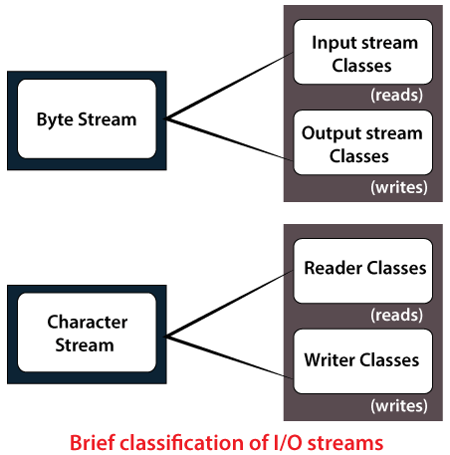

Slide 12
Byte Stream
Byte Stream is mainly involved with byte data. A file handling process with a byte stream is a process in which an input is provided and executed with the byte data.
Character Stream
Character Stream is mainly involved with character data. A file handling process with a character stream is a process in which an input is provided and executed with the character data
File Operations
We can perform the following operation on a file:
Create a File
Get File Information
Write to a File
Read from a File
Delete a File

Slide 13
Create NewFile()
Create a File operation is performed to create a new file. We use the createNewFile() method of file. The createNewFile() method returns true when it successfully creates a new file and returns false when the file already exists.
Get File Information
The operation is performed to get the file information. We use several methods to get the information about the file like name, absolute path, is readable, is writable and length.
Write to a File
The next operation which we can perform on a file is "writing into a file". In order to write data into a file, we will use the FileWriter class and its write() method together. We need to close the stream using the close() method to retrieve the allocated resources.
}

Slide 14
Read from a File
The next operation which we can perform on a file is "read from a file". In order to write data into a file, we will use the Scanner class. Here, we need to close the stream using the close() method. We will create an instance of the Scanner class and use the hasNextLine() method nextLine() method to get data from the file.
Delete a File
The next operation which we can perform on a file is "deleting a file". In order to delete a file, we will use the delete() method of the file. We don't need to close the stream using the close() method because for deleting a file, we neither use the FileWriter class nor the Scanner class.

